Slide 1
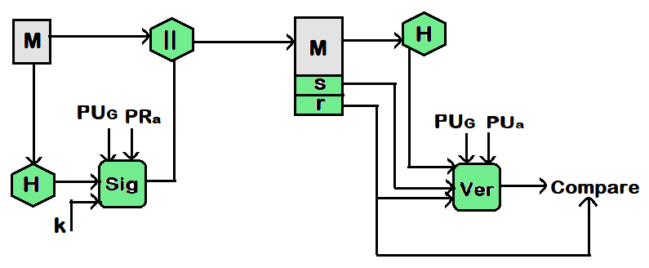

BCSE309L - Cryptography and Network Security
Module 5 - Digital Signature Standard (DSS)

Slide 2
Digital Signature Standard (DSS)

Slide 3
Digital Signature Standard (DSS)
The National Institute of Standards and Technology (NIST) has published Federal Information Processing Standard FIPS 186, known as the Digital Signature Standard (DSS)
The DSS makes use of the Secure Hash Algorithm (SHA)
The DSS was originally proposed in 1991 and revised in 1993 in response to public feedback concerning the security of the scheme

Slide 4
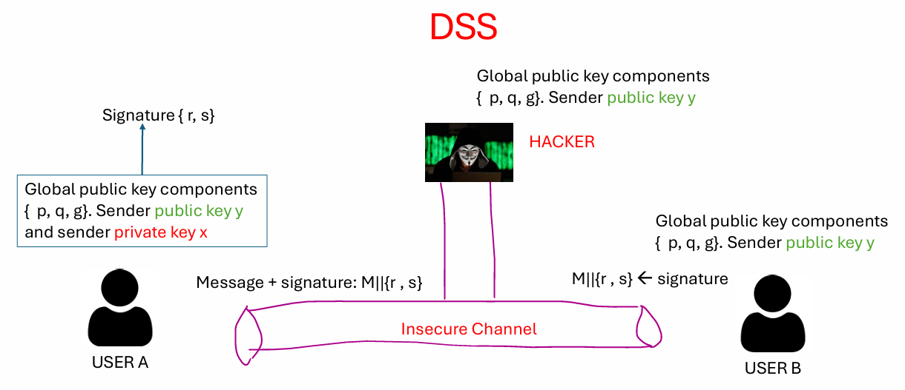

Slide 5
DSS Steps
Generation of Public Key and Private Key for User A
Creation of Digital Signature by User A for a Message M
User B Verifying the Digital Signature

Slide 6
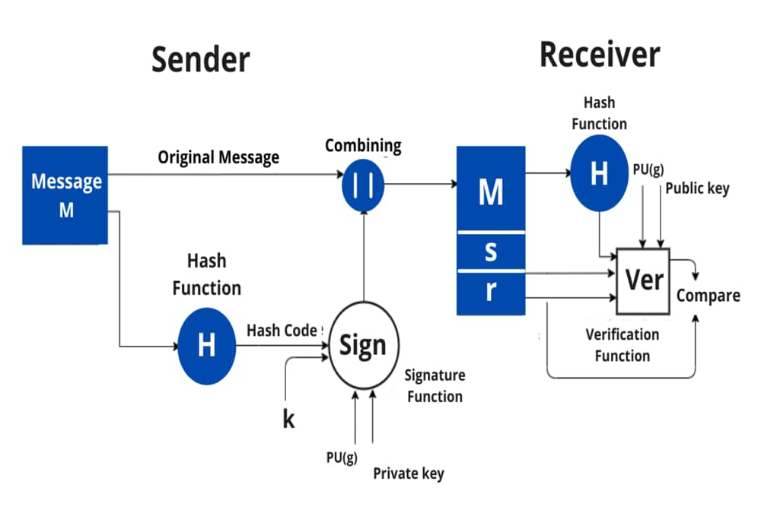
Overview of DSS

Slide 7
The DSA (Digital Signature Algorithm)
Generation of a global public key component
Find a prime number p such that 2^{L-1} < p < 2^{L}, where L is multiple of 64 and an integer between 512 and 1024 i.e., 512 <= L <= 1024; bit length between 512bits and 1024bits in increments of 64bits
Find another number q which is a prime divisor of (p-1)
Compute g = h^{(p-1)/q} mod p, where h is an any integer with 1 < h < (p-1) such that h^{(p-1)/q} mod p > 1

Slide 8
The DSA (Digital Signature Algorithm) Step 2
Finding the user’s private and public keys
The private key, x is any random number such that 0 < x< q
The public key, y = g^{x} mod p

Slide 9
The DSA (Digital Signature Algorithm) Step 3
Generating the Signature
Finding the components of signature s and r
r = (g^{k} mod p) mod q
s = [k⁻¹ {H(M) + x*r}] mod q, where k is a pseudo random integer such that 0<k<q
Signature = (r, s)

Slide 10
The DSA (Digital Signature Algorithm) Step 4
Verifying the signature
Let M’, r’, and s’ be the message and signature components received corresponding to M, r, and s
To verify whether the signature is valid or not, first, the following condition needs to be checked:
0 < r’ < q and 0 < s’ < q
If any of the above conditions are not met, the signature is considered invalid and is therefore discarded; otherwise, if both conditions are met, the following parameters are computed:

Slide 11
The DSA (Digital Signature Algorithm) Step 4 – cont…
w = (s’)⁻¹ mod q
u₁ = [H(M’)w] mod q
u₂ = (r’) w mod q
v = [(g^{u1} y^{u2}) mod p] mod q
Test: v = r’
If v = r’, the signature is correct; otherwise, the data or message has been altered

Slide 12
Problem
Given:
Prime modulus p=23
Subgroup order q=11
Generator g=2
Private key x=3
Random number k=6
Message hash H(M)=9
Find the digital signature (r,s) and verify it.

Slide 13
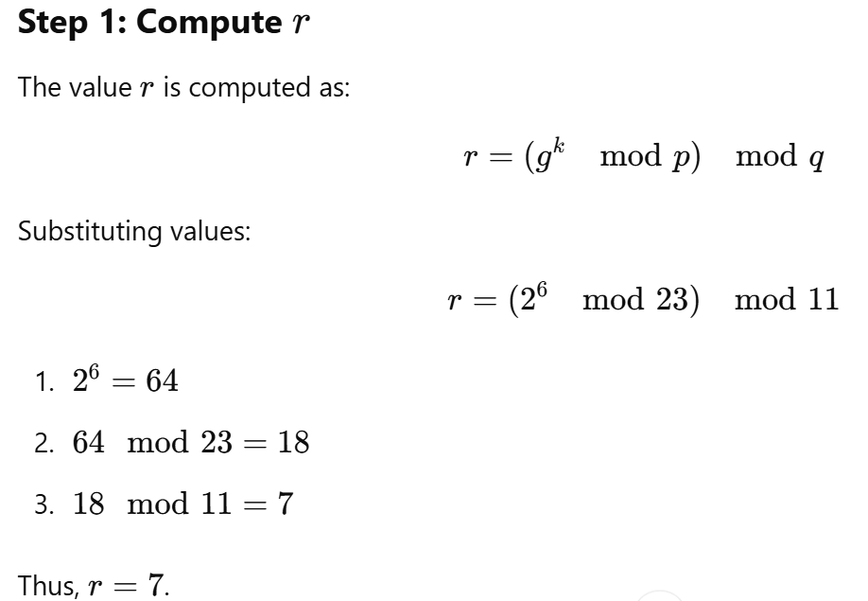
Solution

Slide 14
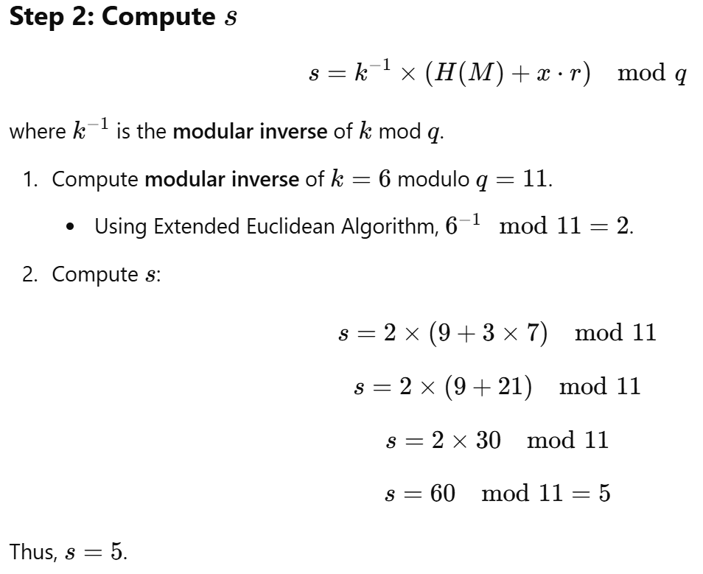

Slide 15
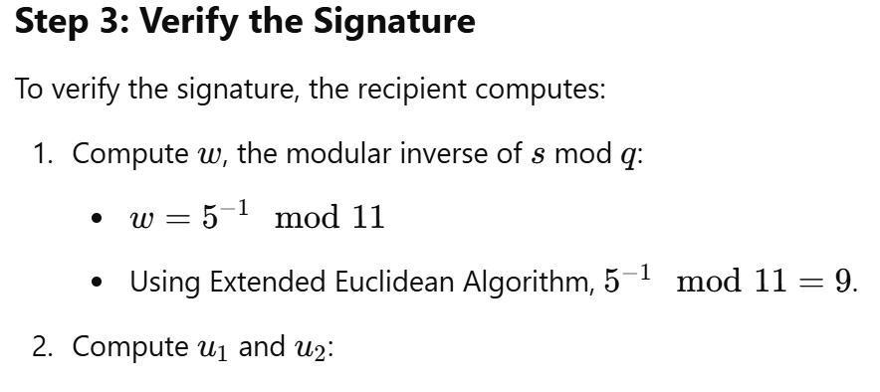
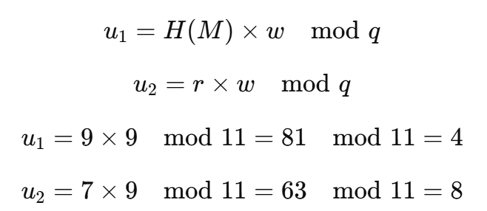

Slide 16
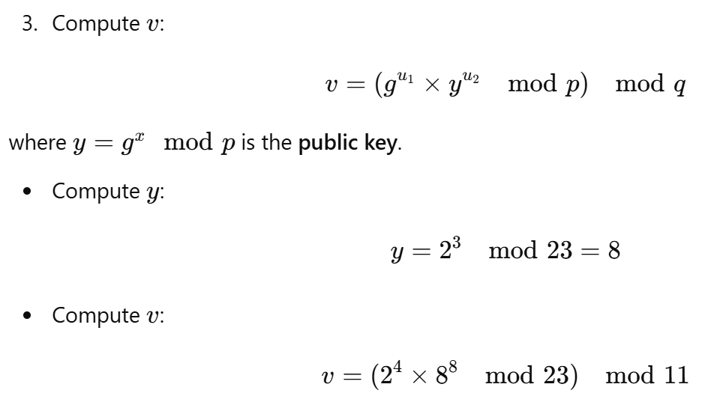
= 18 mod 11 = 7

Slide 17
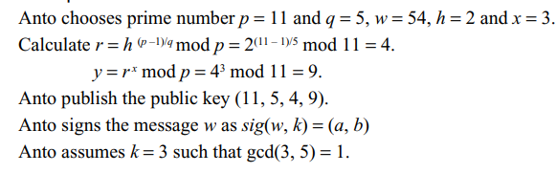
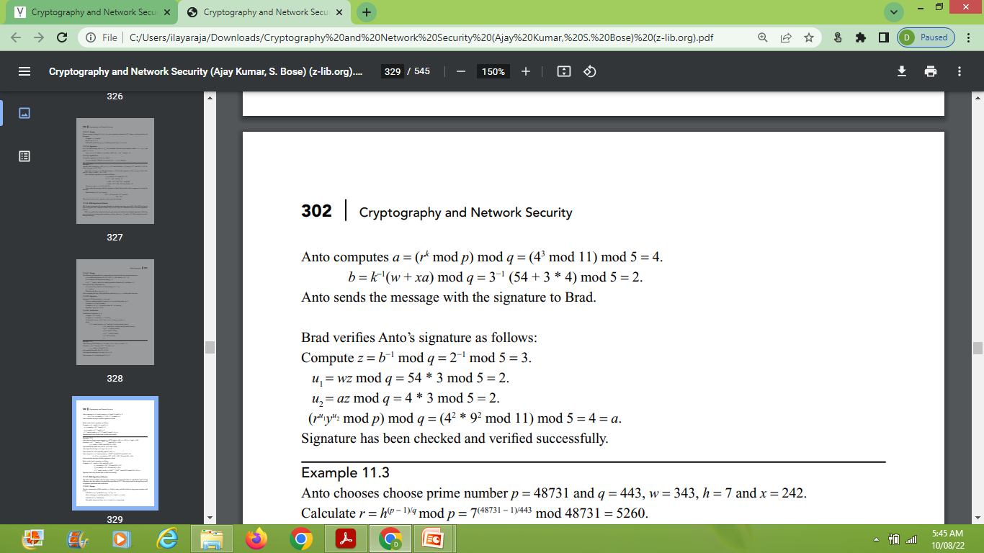
Example 2
Compute g,
public key, y

Slide 18
Exercise
Inputs are,
prime number p = 48731 and q = 443,
w = 343, h = 7, x = 242, k = 427
Find the digital signature (r,s) and verify it.

Slide 19
Summary

Slide 20
Digital Signatures Digital Signature Standard (DSS)
published
NIST Federal Information Processing Standard (FIPS 186)-DSS
DSS Secure Hash Algorithm (SHA)
new Digital Signature Algorithm (DSA)
DSS (1991) (1993,1996)
DSS (2000) (FIPS 186-2)
DSS (2009) (FIPS 186-3)
use
presented
proposed
revised
expand-version
presented
updated
presented

Slide 21
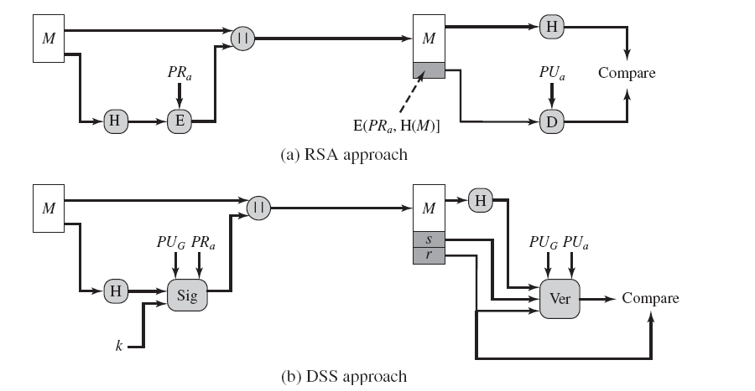
Digital Signatures Digital Signature Standard (DSS)
verify
random number

Slide 22
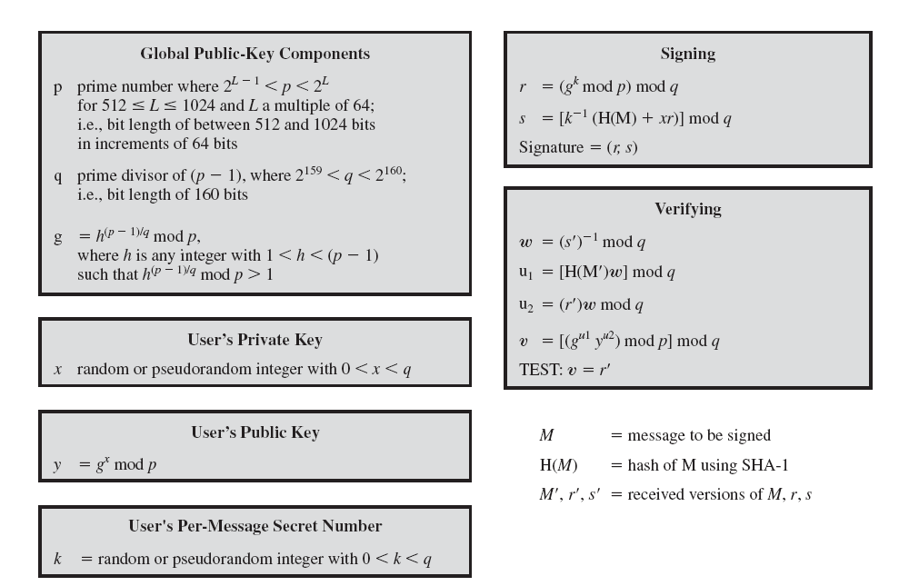
Digital Signatures Digital Signature Algorithm (DSA)

Slide 23
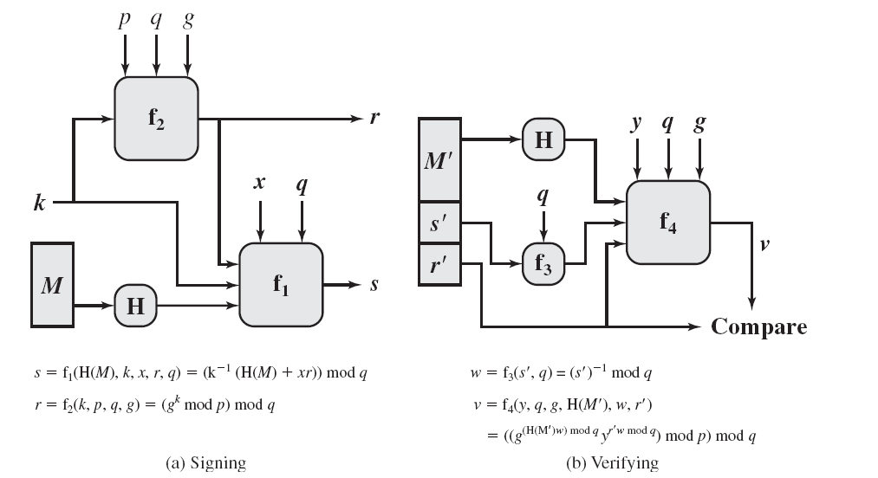
Digital Signatures Digital Signature Algorithm (DSA)

Slide 24
Digital Signatures Digital Signature Algorithm (DSA)
Let p, q, g are public to all
p = 1279 prime number
q = 71 (prime divisor of (p-1))
g = 3¹⁸ mod 1279 = 1157
Let x = 15, k = 10
y = 1157¹⁵ mod 71 = 851
User’s private key:{x = 15}
User’s public key: {y = 851}

Slide 25
Digital Signatures Digital Signature Algorithm (DSA)
Signing
r = (1157 ¹⁰ mod 1279) mod 71 = 32
s = [10 ⁻¹ (123 + 15 x 32)] mod 71 = 39
m = 123, Signature = {32, 39}
Verifying
W = 39⁻¹ mod 71 = 51
u₁ = 123 x 51 mod 71 = 25
u₂ = 32 x 51 mod 71 = 70
ν = [(1157²⁵ 851⁷⁰) mod 1279] mod 71 = 32
Test: ν = r the signature is valid

